Slide 1
Systems Biology and Category Theory
The essence of mathematics lies in its freedom.
-Georg Cantor

Slide 2
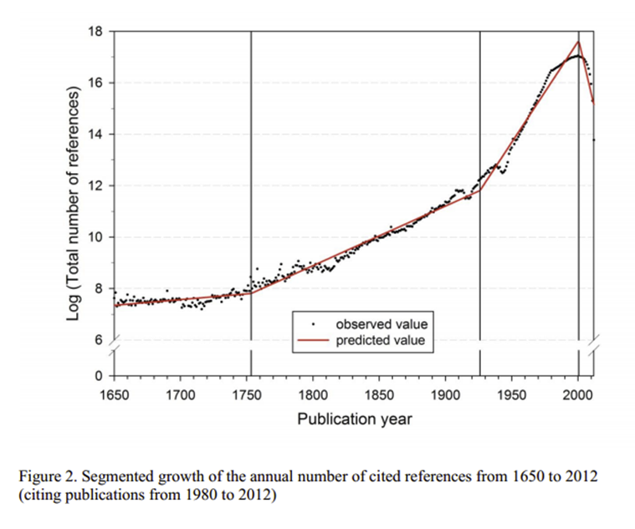
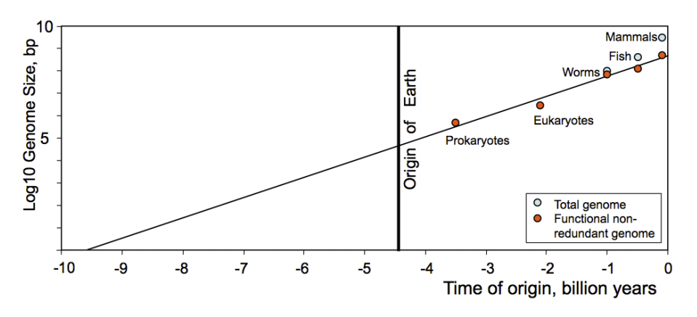
What is Life
Self-Propagating
Obeys a form of natural selection
→ Emergent Qualities
→ Exponential increases in complexity

Slide 3
Standard Definition of Life
Homeostasis: Regulation of the internal environment to maintain a constant state; for example, electrolyte concentration or sweating to reduce temperature.
Organization: Being structurally composed of one or more cells — the basic units of life.
Metabolism: Transformation of energy by converting chemicals and energy into cellular components (anabolism) and decomposing organic matter (catabolism). Living things require energy to maintain internal organization (homeostasis) and to produce the other phenomena associated with life.
Growth: Maintenance of a higher rate of anabolism than catabolism. A growing organism increases in size in all of its parts, rather than simply accumulating matter.
Adaptation: The ability to change over time in response to the environment. This ability is fundamental to the process of evolution and is determined by the organism's heredity, diet, and external factors.
Response to stimuli: A response can take many forms, from the contraction of a unicellular organism to external chemicals, to complex reactions involving all the senses of multicellular organisms. A response is often expressed by motion; for example, the leaves of a plant turning toward the sun..
Reproduction: The ability to produce new individual organisms, either asexually from a single parent organism, or sexually from two parent organisms or "with an error rate below the sustainability threshold."

Slide 4
Drawbacks:
Too many axioms!
→ Not very generalizable
Ex:
  Viruses
  Ant colonies
  Gaia hypothesis
  Cities, companies, governments, etc.

Slide 5
A Different Approach
Living Systems Biology:
  “attempts to map general principles for how all living systems work”
  “explores phenomena in terms of dynamic patterns of the relationships of organisms with their environment.”
  “life is a property of an ecological system rather than a single organism or species”
Relational Biology → Categorical biology
Stochastic Petri Nets

Slide 6
“Relational Theory of Systems”
Developed by Robert Rosen in 1958
Motivation: Many organisms have proteins which perform the same function but are chemically different:
  beef insulin vs human insulin
  Hemoglobin vs Hemocyanin
Suggests a need to divorce physical substrate “fine structure” from relational structure “coarse structure”

Slide 7
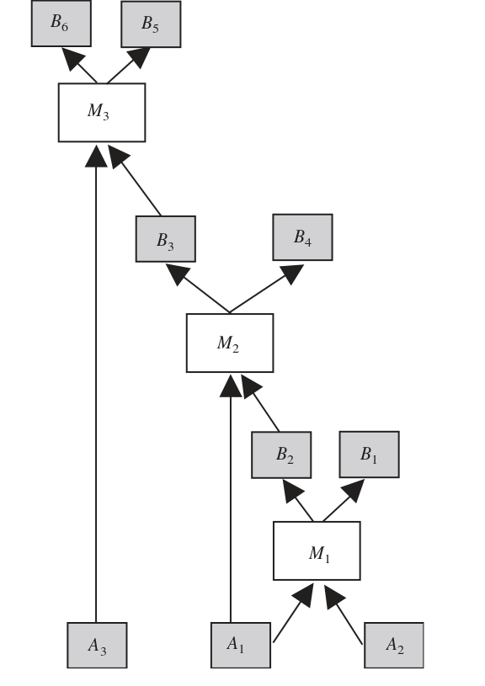
Basic Terminology of the Theory
A system M has components M₁, M₂..M_{n}
These components take in inputs (chemicals) and produce outputs
A subsystem M' is a subset of components of M such that M' receives no inputs from a component that is not in M' (Its closed)
The dependent set S_{i} is the set of environmental outputs that are not produced when M_{i} is inhibited.
If M_{i} is a terminal, then the terminal set T_{i} is the set of environmental outputs produced by a given M_{i}
The inputs of a given component are represented by I(M_{i})

Slide 8
The (M,R) system
Lets apply some assumptions to make this more applicable:
M is connected
Non-Contractibility: Each M_{i} does not produce its outputs unless all inputs are present
Each component M_{i} has a finite lifetime until the component breaks
For each M_{i} there exists a repair system R_{i} which will repair M_{i} from inputs I(R_{i}), also R_{i} is non-contractible
T_{i} ∩(U I(R_{j}) ) is nonempty
  Every terminal component outputs an input of some R_{i}
  What I call the “Relevancy Assumption”

Slide 9
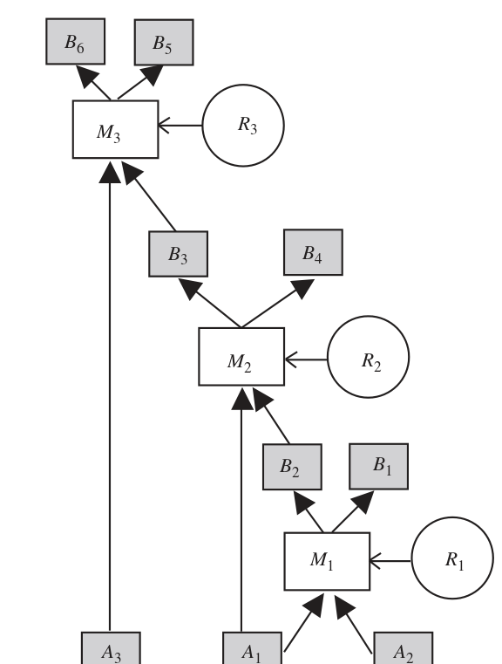
(M,R) systems Theorem 1
If a component M _{i} is inhibited either:
  The whole system fails (central component)
  There exists a unique maximal subsystem that is unaffected
Proof Sketch:
  If M_{J} not inhibited →
  R_{J} not inhibited →
  Terminals producing inputs to R_{j} not inhibited
  Consider the set of all such non inhibited terminals, Rj and Mj.
    There are no inputs from outside the set because everything else is inhibited, and every component is non-contractible

Slide 10
Theorem 2
A component M_{i} is re-establishable iff
  I(R_{i}) ∩ S_{i} is empty
In a (M,R) it is impossible for every component to be re-establishable
Corollary:
  There always exists a central set
  Nucleus of the (M,R) system

Slide 11
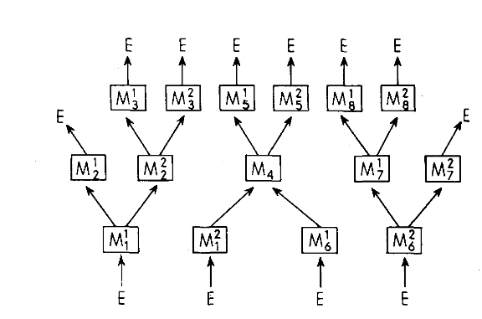
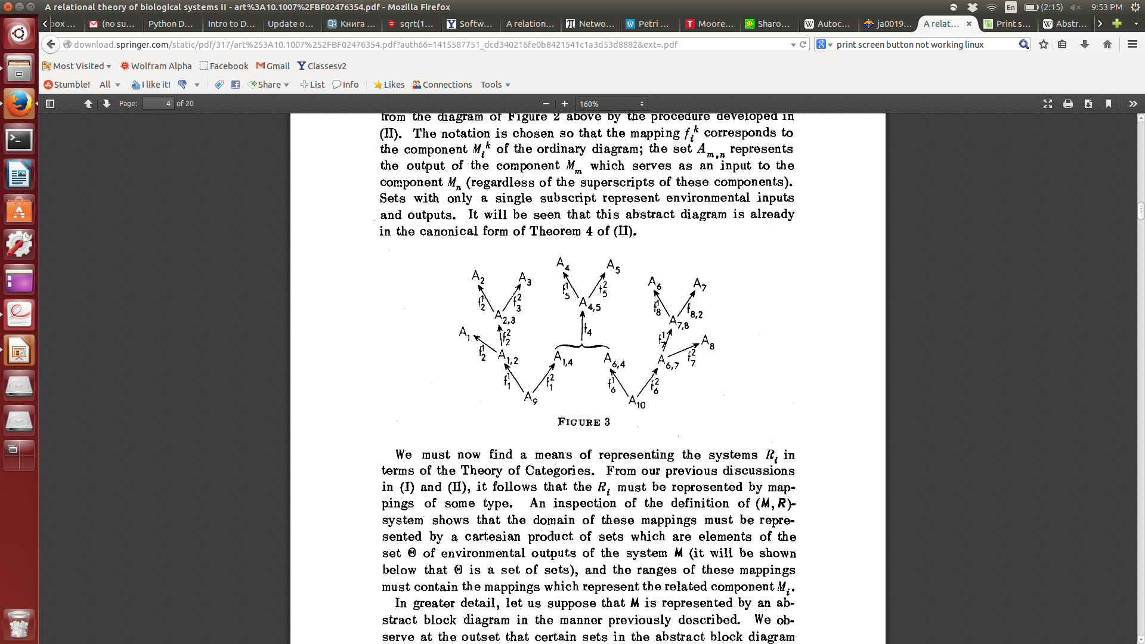
Translating to Category Theory
Each input/output is an object in sets A, B respectively
Each component is a mapping between inputs and outputs: M_{i} is an element of Hom(A,B)
Each repair component is an element of Hom(B,Hom(AB))

Slide 12
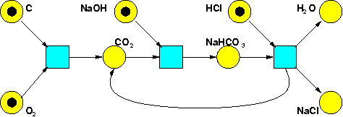
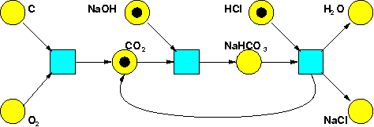
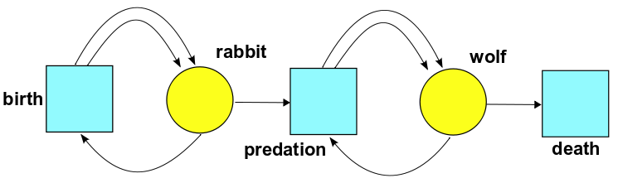
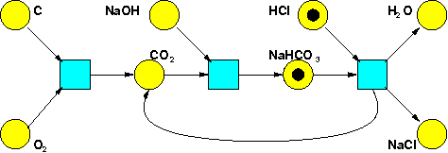
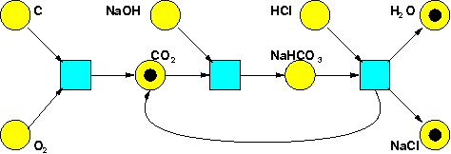
Petri Nets
Time

Slide 13
More Formally
Petri Net: A set of states S, and Transitions T, and an input and output function which gives the amount of inputs needed and the amount of outputs produced
  I: S x T → N , O: S x T → N
Stochastic Petri Nets also have a function
  R: T → (0,∞)
Which serves as a rate constant

Slide 14
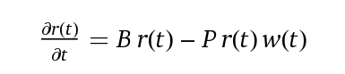
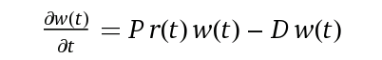
Rate Equations: An example
The Rate Equation says how the expected number of things in each state changes with time
Let r(t) number of rabbits, w(t) be the number of wolves
P
B
D

Slide 15
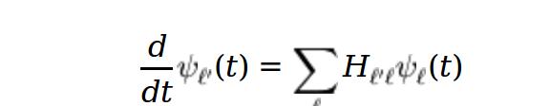
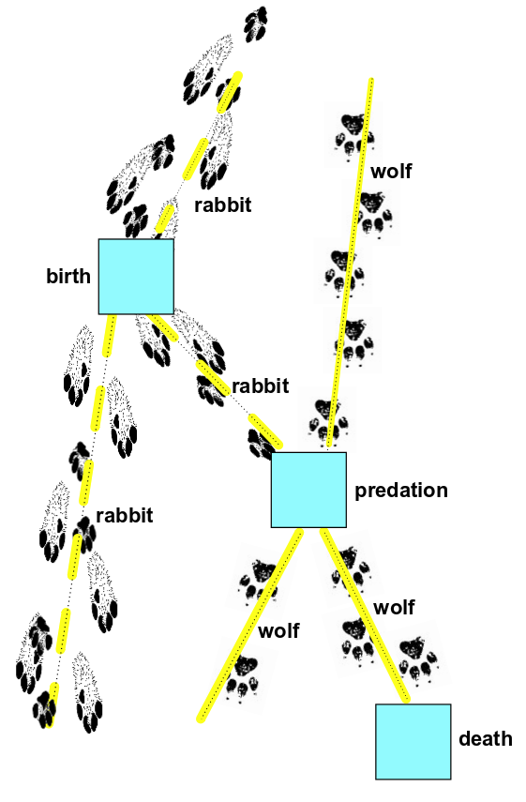
Master Equation in Brief
The master equation says how the probability that we have a given number of things in each state changes with time.
The probability that a given transition occurs in a short time t is approximately the product of:
  the rate constant for that transition
  the time t
  the number of ways the transition can occur.

Slide 16
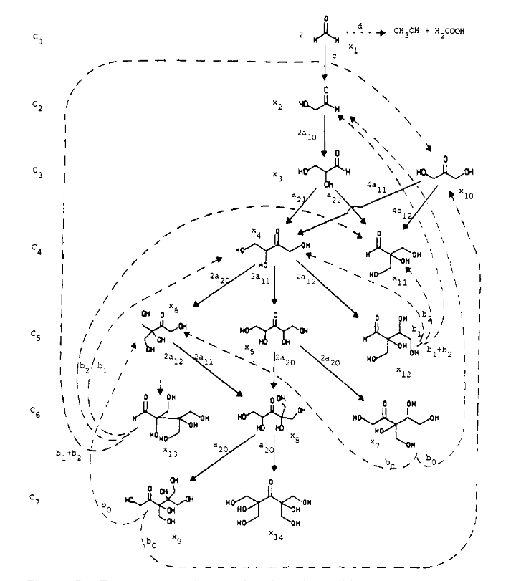
Relation to life systems
A system is self-reproducing if there is a finite sequence of transitions (i.e., reactions) that results in the increase of the numbers of all components within the system.
These reactions propagate until all available resources are consumed
Petri Nets can compete for resources

Slide 17
Works Cited
http://www.technologyreview.com/view/513781/moores-law-and-the-origin-of-life/
en.wikipedia.org/wiki/Life
http://en.wikipedia.org/wiki/Gaia_hypothesis
http://blogs.nature.com/news/2014/05/global-scientific-output-doubles-every-nine-years.html
http://download.springer.com/static/pdf/601/art%253A10.1007%252FBF02477890.pdf?auth66=1414376688_96c9d7921fdfa3b8e49e63cca9fda2ad&ext=.pdf
http://vbm-ehr.pagesperso-orange.fr/ChEh/articles/Kainen.pdf
http://vbm-ehr.pagesperso-orange.fr/AnintroT.htm
http://bip.cnrs-mrs.fr/bip10/rosen.pdf

